Slide 1
Data Storage and Visualization for Design of Experiments
By Wenjie Shao

Slide 2
The motivation behind the project
Do experiments
Create or update the excel sheets
Data normally unorganized
Get lost when trying to extract useful information
Do experiments
Go to the website
Type in data
Automatically create/update database
Data can be cleaned by simply “click button”

Slide 3
Target of the project
User-Friendly: Create websites that interact with users for CRUD
MySQL vs Excel: Use MySQL as data storage instead of manually creating numerous excels for different projects
Security: Add Login Page that authorize users to certain projects, not all

Slide 4
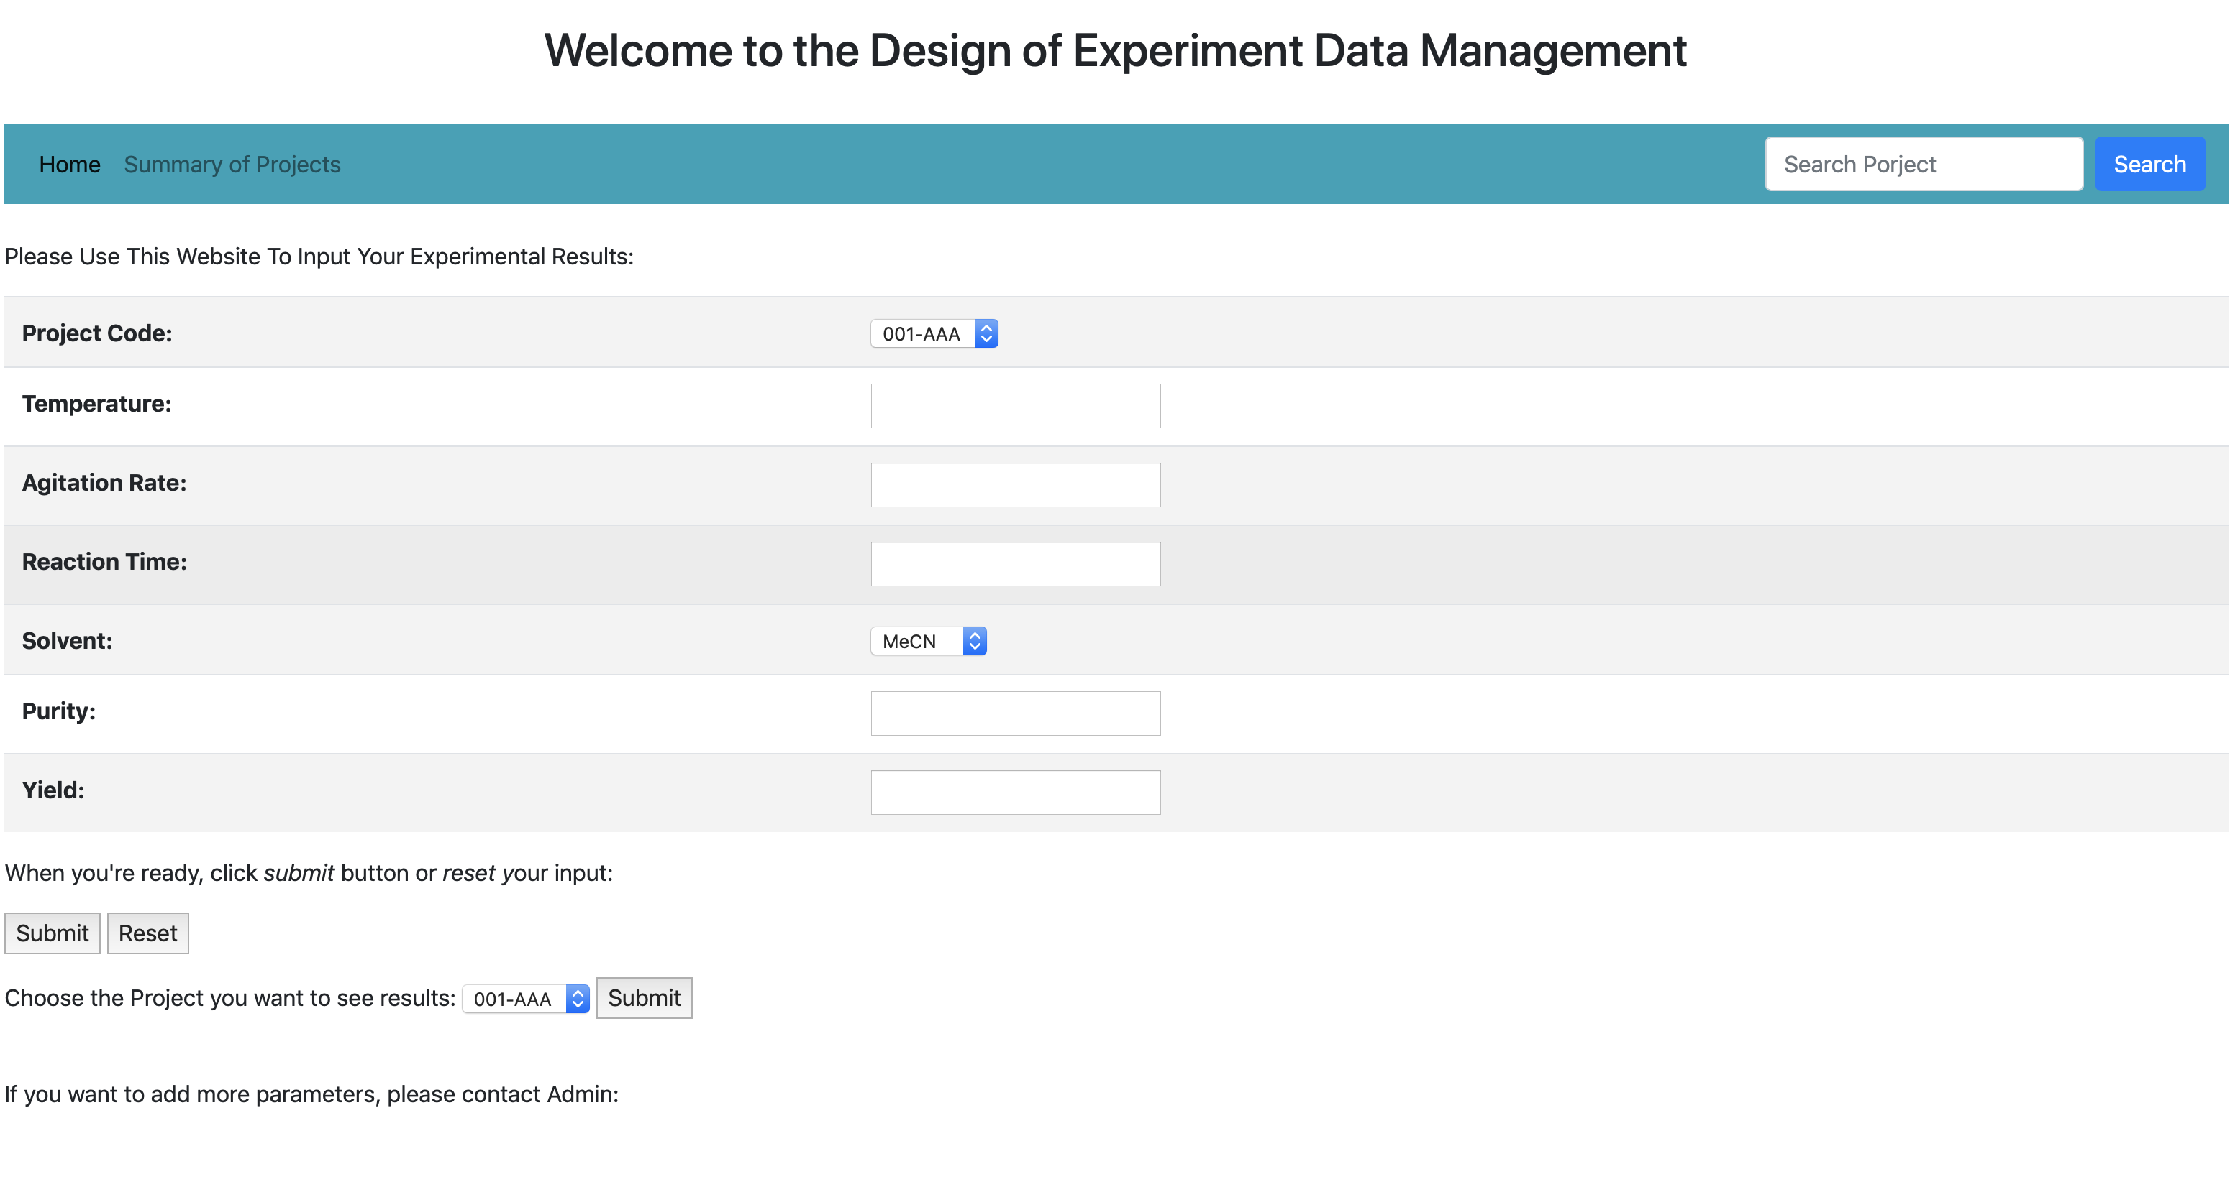

Slide 5
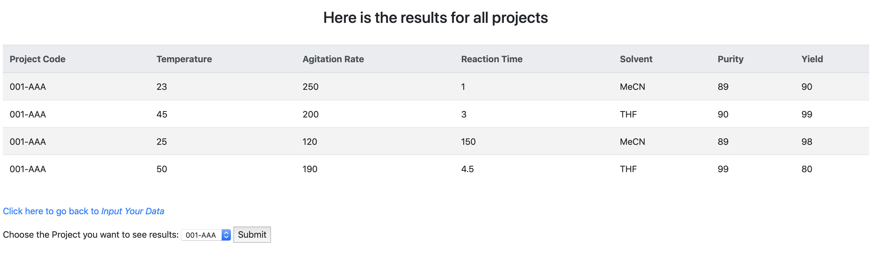

Slide 6
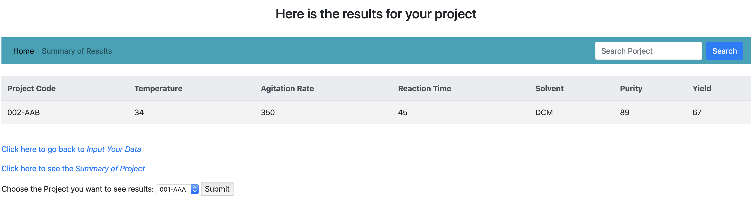

Slide 7
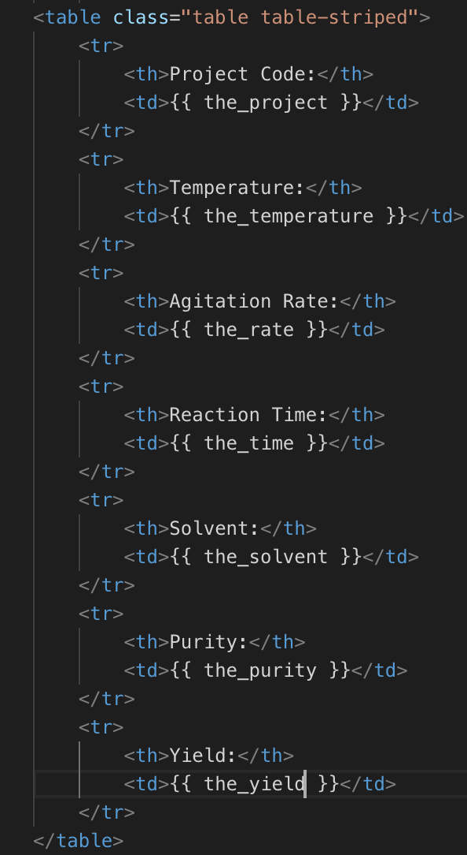
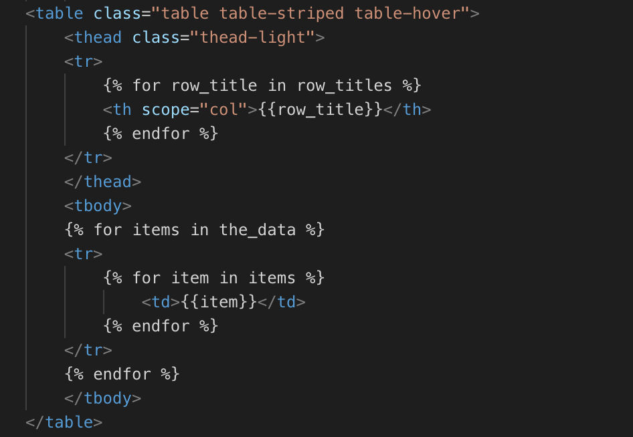
Use Jinja2 template to enable python type variables in html

Slide 8
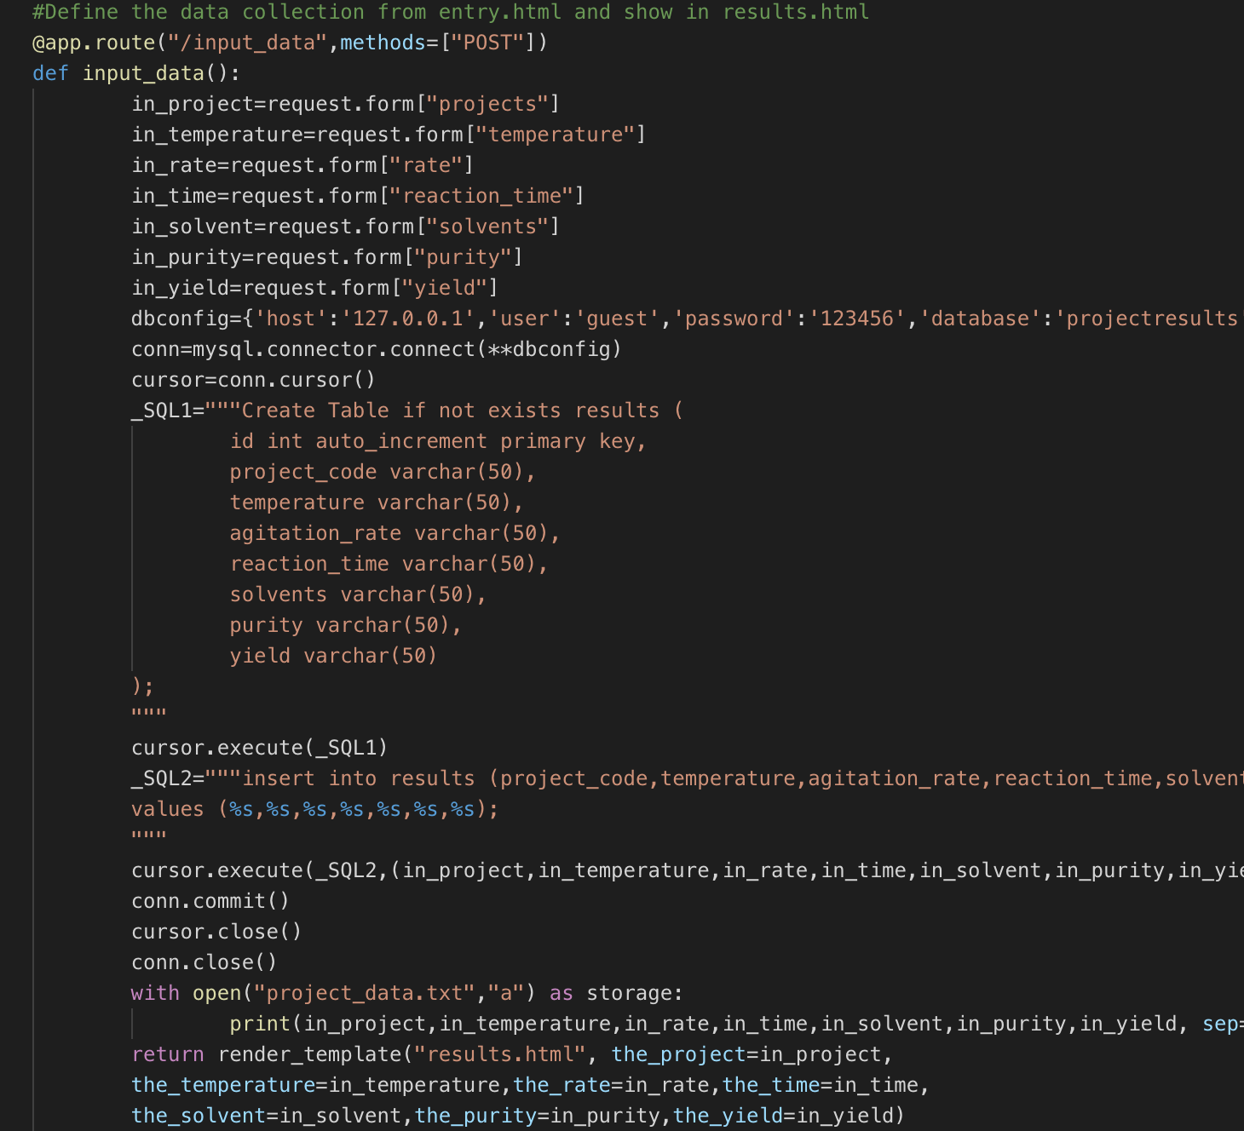
Accept input data from the home page, save into MySQL database as well as a text file and display the result

